Slide 1
Test Managment

Slide 2
Outline
Test organization
Test planning and estimation
Test Plan vs Test Strategy
Importance of a Test Plan
How to create a Test Plan
Test progress monitoring and control
Configuration management
Risk and testing
Defect management

Slide 3
Test organization and independence
Testing software and developing (building) software are not the same
Different tasks involved
Require different mindsets from testers and developers
Testing is an assessment of quality
Assessments are not always positive
Separate the testers from the developers
Improve defect finding by using independent testers
Avoid author bias --> Objective assessments

Slide 4
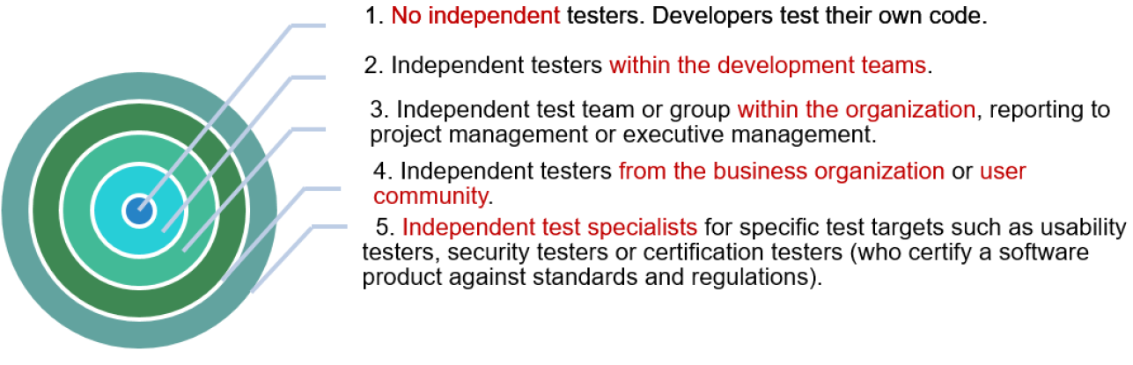
Test organization and independence
The effectiveness of finding defects by testing and reviews can be improved by using independent testers
Options for independence are:

Slide 5
Test organization and independence
For large, complex or safety critical projects, it is usually best to have multiple levels of testing , with some or all of the levels done by independent testers
Development staff can participate in testing, especially at the lower levels

Slide 6
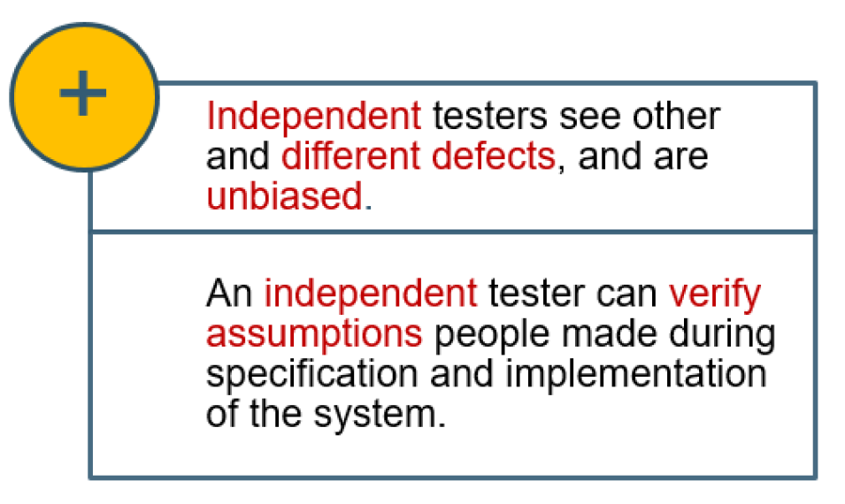
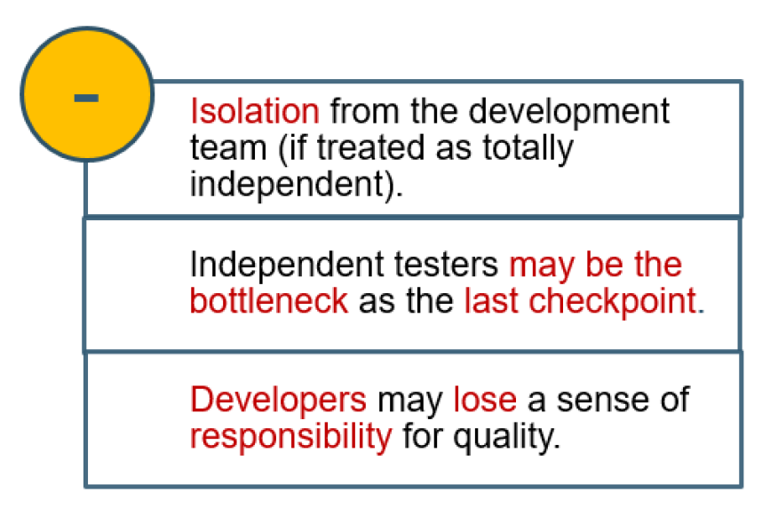
Advantages & disadvantages

Slide 7
Advantages & disadvantages
Note
Testing tasks may be done by people in a specific testing role, or may be done by someone in another role, such as:
project manager
quality manager
developer
business and domain expert
infrastructure or IT operations
(this can be both good and bad)

Slide 8
Tasks of the test leader and tester
There is wide variation in the roles that people within the test team play. The two most common roles are
test leader
tester
Test leader = test manager / test coordinator.
The test leader plans, monitors and controls the testing activities and tasks.
The tester
The tester reviews and contributes to test plan, analyses, designs, prepares, implements and executes tests.

Slide 9
Tasks of the test leader
Coordination | of the test strategy and plan with project managers
Plan the tests | Understanding the test objectives and risks –including: selecting test approaches estimating the time, effort and cost of testing acquiring resources defining test levels, cycles planning defect management
Test specifications, preparation and execution | Initiate the specification, preparation, implementation and execution of tests monitor the test results check the exit criteria
Adapt planning | based on test results and progress and take any action to compensate for problems
Manage test configuration | Set up adequate configuration management for traceability
Introduce metrics | For measuring test progress and evaluating the quality of testing & product
Automation of tests | Decide what should be automated, to what degree, and how
Select test tools | Select tools to support testing and organize trainings for tool users
Test environment | Decide about the implementation of the test environment
Test summary reports | Write test summary reports based on the information gathered during testing

Slide 10
Tasks of the tester
Test plans | Review and contribute to test plans
Requirements and specifications | Analyze review and assess user requirement s, specifications and models for testability.
Test specifications | Create test specifications
Test environment | Set up the test environment (often coordinating with system administration and network management).
Test data | Prepare and acquire test data
Testing process | Implement tests on all test levels, execute and log the tests, Evaluate the results and document the deviations from expected results.
Test tools | Use test tools (for management or monitoring) as required
Test automation | Automate tests (may be supported by a developer or a test automation expert)
Other metrics | Measure performance of components and systems (if applicable)
Help the others | Review tests developed by others

Slide 11
Skills
People involved in testing need
Application or business domain
A tester must understand the intended behavior and the problem the system will solve in order to spot improper.
Technology
A tester must be aware of issues, limitations and capabilities of the chosen implementation technology, in order to locate problems and the 'likely to fail' functions and features.
Testing
A tester must know the testing topics discussed in this book in order to carry out the test tasks assigned.

Slide 12
Skills
People involved in testing
need basic professional and social qualifications such as
literacy
the ability to prepare and deliver written and verbal reports
the ability to communicate effectively
…

Slide 13
Test planning and estimation
Who will do
what,
when
and how

Slide 14
The purpose of a test plan
A test plan is the project plan for the testing work to be done.
Writing a test plan forces us to confront the challenges that await us and focus our thinking on important topics.
The test planning process and the plan itself serve as vehicles for communicating with other members of the project team, testers, peers, managers and other stakeholders.
The test plan also helps us manage change. As we gather more information, we revise our plans.

Slide 15
Test planning
Planning may be documented in:
a project or master test plan
and in separate test plans for test levels, such as integration testing, system testing and acceptance testing.
Test planning is a continuous activity and is performed in all life cycle processes and activities.
Feedback from test activities is used to recognize changing risks so that planning can be adjusted.

Slide 16
Test planning
Test policy of the organization
Scope of testing
Objectives, risks, constraints
criticality, testability and the availability of resources
Outlines of test planning documents are covered by the ‘Standard for Software Test Documentation’ (IEEE 829).

Slide 17
Test planning activities
Scope and risk | Determining the scope and risks of testing
Objectives | Identifying the objectives of testing
Overall approach | Defining the overall approach of testing, including: the definition of the test levels entry and exit criteria
Test activities | Integrating and coordinating the testing activities into the software life cycle activities: acquisition and supply development operation Maintenance
Strategy | Making decisions about: what to test what roles will perform the test activities how the test activities should be done and how the test results will be evaluated
Schedule | Scheduling test analysis and design activities Scheduling test implementation, execution and evaluation
Resources | Assigning resources for the different activities defined.
Metrics | Selecting metrics for monitoring and controlling test preparation and execution, defect resolution and risk issues.

Slide 18
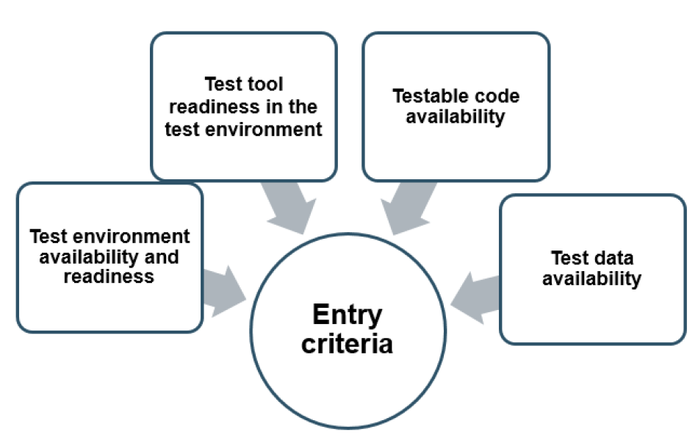
Entry criteria
Entry criteria defines when to start testing

Slide 19
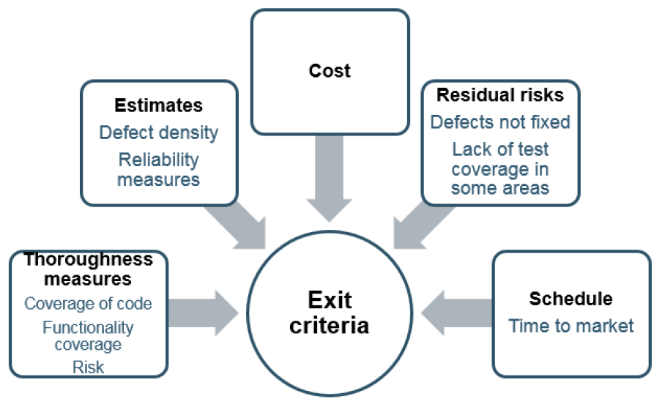
Exit criteria
Exit criteria is to define when to stop testing , such as at the end of a test level, end of project or when a set of tests has a specific goal.

Slide 20
Test estimation
The testing work is usually a subproject within the larger project.
Fundamental techniques of estimation can be adapt for testing
We can break down a testing project into phases
planning and control
analysis and design
implementation and execution
evaluating exit criteria and reporting
test closure
Within each phase we identify activities and within each activity we identify tasks and perhaps subtasks .

Slide 21
Test estimation
To identify the activities and tasks, we work both
forward
Backward
To ensure accuracy of the estimate, make sure that you subdivide the work into tasks that are short in duration, say one to three days.
If they are much longer say two weeks there will be a risk that long and complex sub tasks are 'hidden' within the larger task.

Slide 22
Test estimation techniques
Two approaches for the estimation of test effort are covered:
The metrics-based approach
The expert-based approach
Estimating the testing effort based
on metrics of former or similar
projects or based on typical values
Estimating the tasks by the owner of
these tasks or by experts

Slide 23
Test estimation
A good solution is to combine the two strategies:
First: create the work-breakdown structure and a detailed bottom-up estimate.
Second: We then apply models and rules of thumb to check and adjust the estimate bottom-up and top-down using past history.
This approach tends to create an estimate that is both more accurate and more defensible than either technique by itself.

Slide 24
Test estimation - an example
Performance tests need to be run in a special test environment that look like the production or field environment, due to the response time and resource utilization
Performance testing involves
special tools to generate load and check response
environment acquisition and configuration
time to identify and hire a performance test professional , if required
training activities, if required
A detailed test plan for performance testing should be written in the test planning phase, where time is required to draft, review and finalize a performance test plan.

Slide 25
Factors affecting the test effort
The testing effort may depend on a number of factors, including:
Product factors | the quality of the specification (the test basis) the size of the product the complexity of the problem domain the importance of non functional quality e.g. usability, performance, security etc.
Process factors | the development model availability of test tools e.g. test executing tools) skills of the people involved time pressure
The outcome of testing | the number of defects the amount of rework required

Slide 26
Test approaches and strategies
The test approach is the implementation of the test strategy for a specific project.
Since the test approach is specific to a project , the approach should be documented in the test plan
One way to classify test approaches or strategies is based on the point in time at which the bulk of the test design work is begun:
Preventative approaches: Tests are designed as early as possible
Reactive approaches: Test design comes after the software or system has been produced

Slide 27
Test approaches and strategies
Analytical approaches | e.g. risk-based testing -testing is directed to areas of greatest risk, requirement based testing
Model based approaches | e.g. testing using statistical information about failure rates (such as reliability growth models)
Methodical approaches | e.g. failure based (including error guessing and fault attacks), experienced based, check list based, and quality characteristic based
Process/standard compliant approaches | e.g. specified by industry specific standards or the various agile methodologies
Dynamic and heuristic approaches | e.g. exploratory testing, execution & evaluation are concurrent tasks.
Consultative approaches | e.g. test coverage is evaluated by domain experts outside the test team.
Regression-averse approaches | include reuse of existing test material, extensive automation of functional regression tests

Slide 28
Test approaches and strategies
The choice of test approaches and strategies is one powerful factor in the success of the effort and the accuracy of the test plans and estimates.
When we choose test strategies there are many factors to consider
Risks
Skills
Objectives
Regulations
Product
Business

Slide 29
Test Plan and Test Strategy
Test Plan reflects test focus and project scope are defined. It deals with test coverage, scheduling, features to be tested, features not to be tested, estimation and resource management.
Test Strategy is a guideline to be followed to achieve the test objective and execution of test types mentioned in the testing plan. It deals with test objective, test environment, test approach, automation tools and strategy, contingency plan, and risk analysis

Slide 30
Test Plan
A test plan is a detailed document that outlines the test strategy, testing objectives, resources (manpower, software, hardware) required for testing, test schedule, test estimation and test deliverables.
The test plan serves as a blueprint to conduct software testing activities as a defined process which is minutely monitored and controlled by the test manager.

Slide 31
Importance of a Test Plan
Test Plan helps us determine the effort needed to validate the quality of the application under test (AUT).
Help people outside the test team such as developers, business managers, customers understand the details of testing.
Test Plan guides our thinking. It is like a rule book, which needs to be followed.
Important aspects like test estimation, test scope, Test Strategy are documented in Test Plan, so it can be reviewed by Management Team and re-used for other projects.

Slide 32
Test Plans
The most common question about testing is
“ How do I write a test plan? ”
This question usually comes up when the focus is on the document, not the contents
It’s the contents that are important, not the structure
Good testing is more important than proper documentation
However – documentation of testing can be very helpful
Most organizations have a list of topics, outlines, or templates

Slide 33
Test Plan
Objectives
To create a set of testing tasks
Assign resources to each testing task
Estimate completion time for each testing task
Document testing standards

Slide 34
Good Test Plans
Developed and Reviewed early
Clear, Complete and Specific
Specifies tangible deliverables that can be inspected
Staff knows what to expect and when to expect it
Realistic quality levels for goals
Includes time for planning
Can be monitored and updated
Includes user responsibilities
Based on past experience
Recognizes learning curves

Slide 35
Standard Test Plan
IEEE Standard 829-2008 is old but still used:
Test Plan
A document describing the scope, approach, resources, and schedule of intended testing activities. It identifies test items, the features to be tested, the testing tasks, who will do each task, and any risks requiring contingency planning
Many organizations are required to adhere to this standard
Unfortunately, this standard emphasizes documentation, not actual testing – often resulting in a well documented vacuum

Slide 36
Test Planning and Preparation
Major testing activities:
Test planning and preparation
Execution (testing)
Analysis and follow-up
Test planning:
Goal setting
Overall strategy
Test preparation:
Preparing test cases & test suite(s)
systematic
Preparing test procedure

Slide 37
Test Planning: Goal setting and strategic planning
Goal setting
Quality perspectives of the customer
Quality expectations of the customer
Mapping to internal goals and concrete (quantified) measurement
Example: customer's correctness concerns => specific reliability target
Overall strategy, including:
Specific objects to be tested
Techniques to use
Measurement data to be collected
Analysis and follow-up activities
Key: Plan the“whole thing"!

Slide 38
Types of Test Plans
Mission plan – tells “why”
Usually one mission plan per organization or group
Least detailed type of test plan
Strategic plan – tells “what” and “when”
Usually one per organization, or perhaps for each type of project
General requirements for coverage criteria to use
Tactical plan – tells “how” and “who”
One per product
More detailed
Living document, containing test requirements, tools, results and issues such as integration order

Slide 39
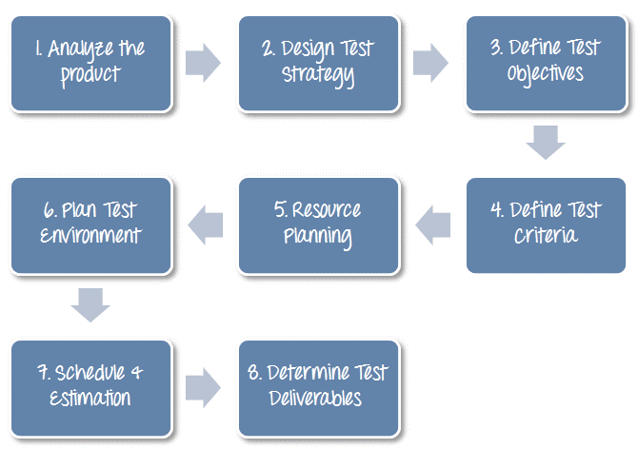
How to write a Test Plan
Creating a Test Plan is the most important task of Test Management Process.

Slide 40
1. Analyze the Project
1. Review product and project documentation
2. Perform product walkthrough
3. Interview client, designer and developer
Can you test a product without any information about it?
No… You must learn a product thoroughly before testing it.
You can use the following approach to analyze the product:

Slide 41
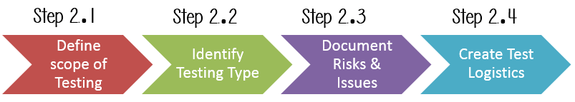
2. Develop Test Strategy
Test Strategy is a critical step in making a Test Plan. This document defines:
The project’s testing objectives and the means to achieve them
Determines testing effort and costs
To develop Test Strategy for testing a product, you should follow steps below:

Slide 42
2. Develop Test Strategy
Step 2.1) Define Scope of Testing
Before the start of any test activity, scope of the testing should be known.
The components of the system to be tested (hardware, software, middleware, etc.) are defined as "in scope"
The components of the system that will not be tested also need to be clearly defined as being "out of scope."

Slide 43
2. Develop Test Strategy
Step 2.1) Define Scope of Testing
To determine scope, you must consider:
Customer requirement
Project Budget
Product Specification
Skills & talent of your test team

Slide 44
2. Develop Test Strategy
Step 2.2) Identify Testing Type
A Testing Type is a standard test procedure that gives an expected test outcome. (many are available..)
The commonly used testing types are:
Unit Test: test the smallest piece of verifiable software in the application.
API Test: test the API’s created for the application
Integration Test: individual software modules combined and tested as group
System Test: conducted on a complete, integrated system to evaluate system’s compliance with its specified requirements
And more …

Slide 45
2. Develop Test Strategy
Step 2.3) Document Risk & Issues
Risk is future’s uncertain event with a probability of occurrence and a potential for loss. When the risk actually happens, it becomes the ‘issue’.
You should document those risks in the Test Plan.

Slide 46
2. Develop Test Strategy
Step 2.3) Document Risk & Issues (Example)
Risk | Mitigation
Team member lack the required skills for website testing. | Plan training course to skill up your members
The project schedule is too tight; it's hard to complete this project on time | Set Test Priority for each of the test activity
Test Manager has poor management skill | Plan leadership training for manager
A lack of cooperation negatively affects your employees' productivity | Encourage each team member in his task, and inspire them to greater efforts.
Wrong budget estimate and cost overruns | Establish the scope before beginning work, pay a lot of attention to project planning and constantly track and measure the progress

Slide 47
2. Develop Test Strategy
Step 2.4) Create Test Logistics
In Test Logistics, the Test Manager should answer the following questions:
Who will test?
When will the test occur?

Slide 48
3. Define Test Objective
Test Objective is the overall goal and achievement of the test execution
A sample of the Objectives for an online bank website:
“The test objectives are to verify the functionality of the website of the bank, the project should focus on testing the banking operation such as Account Management, Withdrawal, and Balance…etc. to guarantee all these operations can work normally in real business environment.”

Slide 49
4. Define Test Criteria
Test Criteria is a standard or rule on which a test procedure or test judgment can be based. There’re 2 types of test criteria as following:
Suspension Criteria: Specify the critical suspension criteria for a test. If the suspension criteria are met during testing, the active test cycle will be suspended until the criteria are resolved.
Example: “If testing team report that there are 40% of test cases failed, you should suspend testing until the development team fixes all the failed cases.”

Slide 50
4. Define Test Criteria
Test Criteria is a standard or rule on which a test procedure or test judgment can be based. There’re 2 types of test criteria as following:
Exit Criteria: It specifies the criteria that denote a successful completion of a test phase. The exit criteria are the targeted results of the test and are necessary before proceeding to the next phase of development.
Example:
“95% of all critical test cases must pass.”

Slide 51
5. Resource Planning
Resource plan is a detailed summary of all types of resources required to complete project task.
Resource could be human, equipment and materials needed to complete a project
The resource planning is important factor of the test planning because it helps in determining the number of resources (employee, equipment…) to be used for the project. Therefore, the Test Manager can make the correct schedule & estimation for the project. (check the Sample Test Plan on Moodle for an example)

Slide 52
6. Plan Test Environment
How do you plan for setting up a test environment for a product?
To finish this task, you need a strong cooperation between Test Team and Development Team
Test team should ask the development team all required details about the product to run to be able to clearly understand the product under test.
Sample of questions:
What is the maximum user connections which this product can handle at the same time?
What are hardware/software requirements to install this product?
Does the user's computer need any particular setting to browse the website?
Other questions …

Slide 53
7. Schedule & Estimation
To do the Schedule and time estimation it is better to break down the whole project into small tasks and add the estimation for each task separately. An example is provided below:
How can we estimate required effort?
Task | Members | Estimate effort
Create the test specification | Test Designer | 170 man-hour
Perform Test Execution | Tester, Test Administrator | 80 man-hour
Test Report | Tester | 10 man-hour
Test Delivery |  | 20 man-hour
Total |  | 280 man-hour

Slide 54
7. Schedule & Estimation
Then you create the schedule to complete these tasks.
To create the project schedule, the Test Manager needs several types of input as below:
Employee and project deadline: The working days, the project deadline, resource availability are the factors which affected to the schedule
Project estimation: Base on the estimation, the Test Manager knows how long it takes to complete the project. So he/she can make the appropriate project schedule
Project Risk : Understanding the risk helps Test Manager add enough extra time to the project schedule to deal with the risks

Slide 55
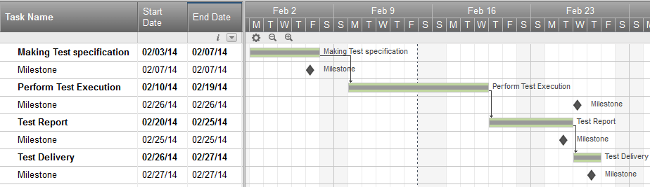
7. Schedule & Estimation
Example:
Suppose that you need to complete testing of your project in one month, you already estimated the effort for each tasks in Test Estimation. You can create a schedule similar to the one below:

Slide 56
8. Test Deliverables
Test Deliverables is a list of all the documents, tools and other components that has to be developed and maintained in support of the testing effort.
There are different test deliverables at every phase of the software development lifecycle:
Before Testing (e.g. test plans, test cases, test design specifications)
During Testing (e.g. test scripts, test data, test traceability matrix, error logs)
After Testing (e.g. test results and reports, defect report, installation guidelines, release notes)

Slide 57
Test progress monitoring
The purpose of test monitoring is to give feedback and visibility about test activities .
Information to be monitored may be collected manually or automatically and may be used to measure exit criteria , such as coverage.
Metrics may also be used to assess progress against the planned schedule and budget.

Slide 58
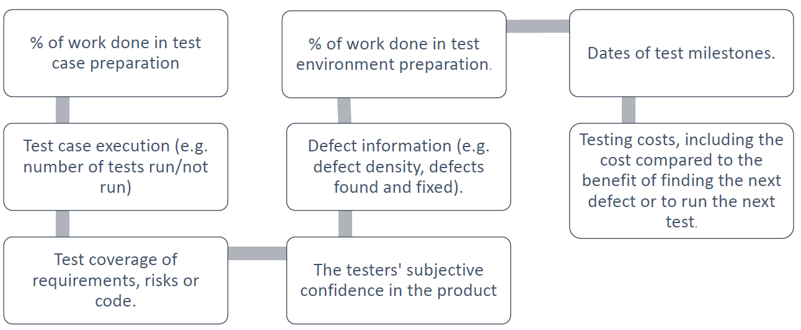
Test progress monitoring

Slide 59
Test log template

Slide 60
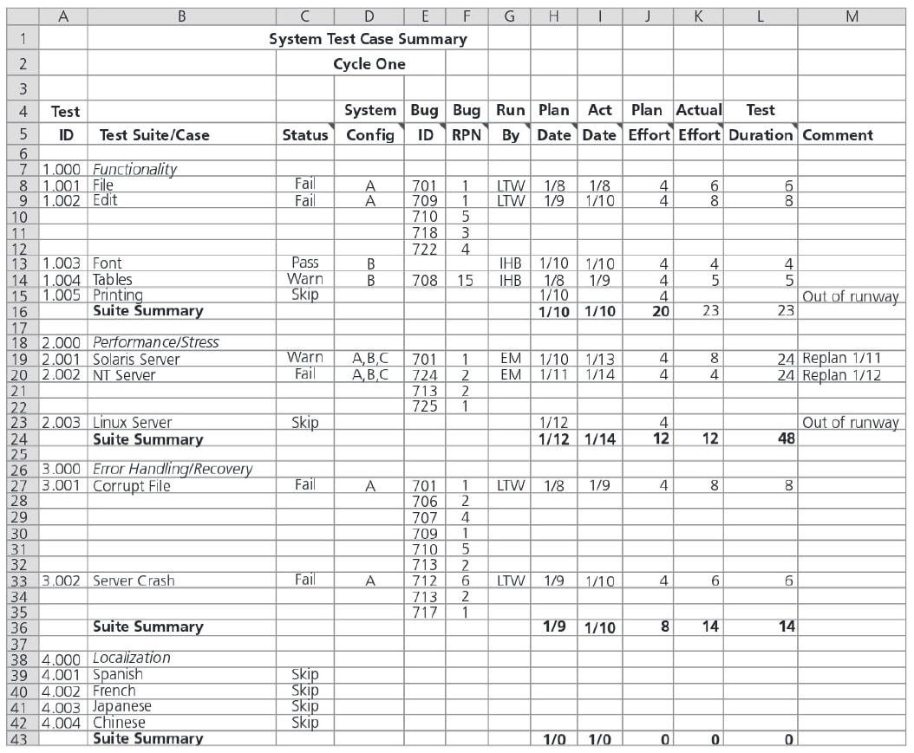
Test case summary - common metrics

Slide 61
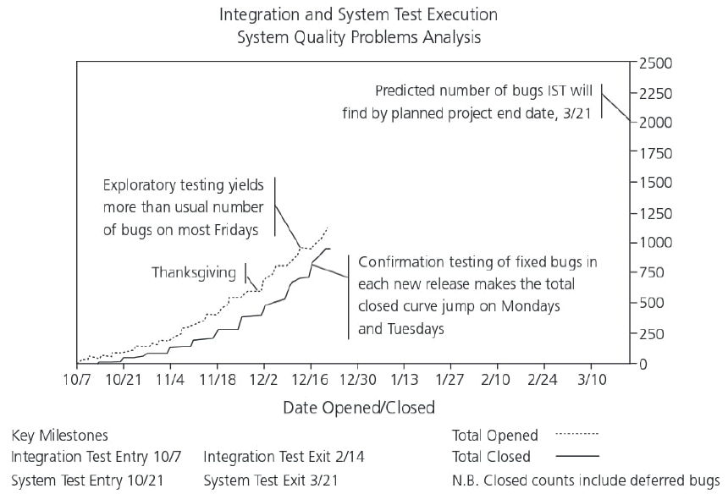
Total defects opened and closed chart

Slide 62
Test reporting
Test reporting is concerned with summarizing information about the testing endeavor, including:
What happened during a period of testing (ex: dates when exit criteria were met)
Analyzed metrics to support decisions about future actions
(ex: the economic benefit of continued testing)

Slide 63
Test reporting
Metrics are collected at the end of a test level in order to assess:
The adequacy of the test objectives for that test level
The adequacy of the test approaches with respect to its objectives
The effectiveness of the testing with respect to its objectives

Slide 64
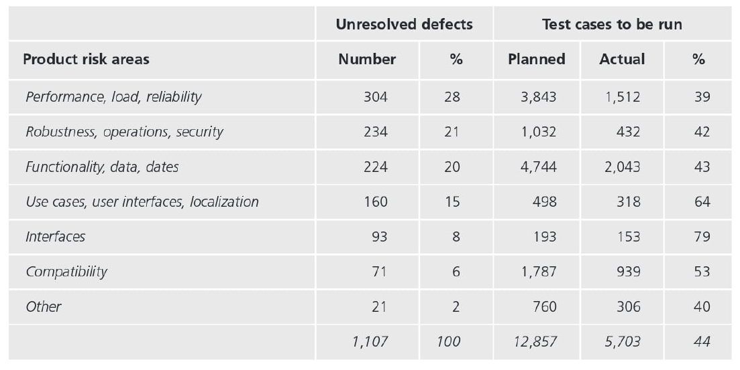
Test reporting

Slide 65
Test summary report - template

Slide 66
Test control
Projects do not always go according to plan.
Different factors can lead to deviations:
New risks
New needs
Test findings
External events
Test environment problems
Test control describes any guiding or corrective actions taken as a result of information and metrics gathered and reported.

Slide 67
Test control
Test control describes any guiding or corrective actions taken as a result of information and metrics gathered and reported.
Examples of test control actions are:
Making decisions based on information from test monitoring
Re-prioritize tests when an identified risk occurs
Change the test schedule due to availability of a test environment
Set an entry criteria requiring fixes to have been tested (confirmation tested) by a developer before accepting them into a build

Slide 68
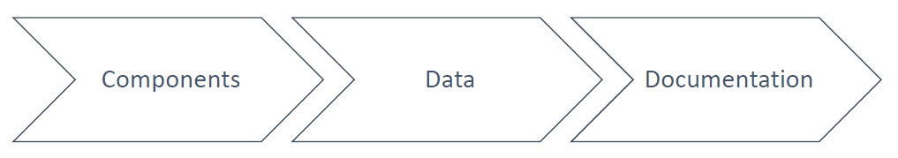
Configuration management
The purpose of configuration management is to establish and maintain the integrity of the software and related products through the project and product life cycle

Slide 69
Configuration management
The configuration management shall ensure that all items are
identified
version controlled
tracked for changes
so that traceability can be maintained throughout the test process
All identified documents and software items should be referenced unambiguously in test documentation.

Slide 70
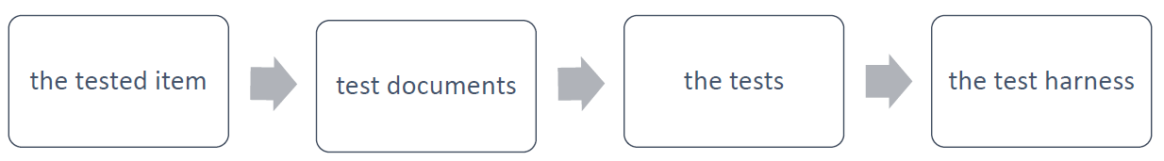
Configuration management
Configuration management helps to uniquely identify (and to reproduce)
Configuration management procedures and tools should be selected during the project planning stage

Slide 71
Configuration management
When testers receive an organized, version controlled test release from a source code repository, it should be accompanied by a test item release note :

Slide 72
Risk and testing
Risk is the possibility of a negative or undesirable outcome, the possible problems that might endanger the objectives of the project stakeholders.
Risks are related to the
product
project
Risk analysis and risk management can help us plot a course for solid testing.

Slide 73
Risk and testing
The level of risk is determined by:
The likelihood of an adverse event happening
The impact: the harm resulting from that event

Slide 74
Risk and testing
For any risks you have four possibilities
Mitigate
Contingency
Transfer
Ignore
When analyzing, managing and mitigating these risks, the test manager should follow well established project management principles

Slide 75
Project risks
Typical project risks
Logistics or product quality problems that block tests
Test items that won't install in the test environment
Excessive change to the product that invalidates test results or requires updates to test cases, expected results and environments
Insufficient or unrealistic test environments that yield misleading results

Slide 76
Project risks
Project risks = the risks that surround the project’s capability to deliver its objectives, such as:
Organizational Factors
Skill and staff shortage
Personal and training issues
Technical Issues
Problems in defining the right requirements
The extent that requirements can be met given existing constraints
Supplier Issues
Failure of a third part
Contractual issues
Problems with testers communicating their needs and test results
Improper attitude toward testing
The quality of design, code, and tests

Slide 77
Project risks
Organizational issues
such as shortages of people, skills or training, problems with communicating and responding to test results, bad expectations of what testing can achieve and complexity of the project team or organization.
Technical issues
such as problems related to ambiguous, conflicting or not prioritized requirements
Supplier issues
problems with underlying platforms or hardware
failure to consider testing issues in the contract
failure to properly respond to the issues when they arise

Slide 78
Product risks
Product risk is a risk directly related to the test object
Product risk is the possibility that the system or software might fail to satisfy some reasonable customer, user, or stakeholder expectation

Slide 79
Product risks
Product risks = Potential failure areas in the software
They are a risk to the quality of the product, i.e.:
Failure-prone software delivered
Software/hardware could cause harm to an individual or company
Poor software characteristics (e.g. functionality, reliability, usability and performance).
Software that does not perform its intended functions.
Risks are used to decide where to start testing and where to test more.

Slide 80
Product risks
Testing is used to
reduce the risk of an adverse effect occurring ,
Reduce the impact of an adverse effect
In a risk based approach the risks identified may be used to:
Determine the test techniques to be employed.
Determine the extent of testing to be carried out.
Prioritize testing in an attempt to find the critical defects as early as possible
Determine whether any non testing activities could be employed to reduce risk e.g. providing training to inexperienced designers).

Slide 81
Risk analysis
Identifying the risk items
Determine the likelihood and impact for each item
Use a rating scale (1 10) classify the level of risk for each item
Priority the risk items according to their rating values

Slide 82
Risk analysis
Risk analyses are educated guesses! Make sure that you follow up and revisit the risk analysis at key project milestones
If you're following a V model, you might perform the analysis during
the requirements phase
at the end of the design phase
at the end implementation phase
prior to starting unit test, integration test, and system test
during testing
You might find you have discovered new risks or found that some risks weren't as risky as you thought and increased your confidence in the risk analysis .

Slide 83
Risk analysis
Risk-based testing also involves measuring how well we are doing at finding and removing defects in critical areas, as was shown in the table:

Slide 84
Risk analysis
Analyze risks early in the project.
You should manage risks appropriately, based on likelihood and impact, but do not confuse impact with likelihood or vice versa
The goal of risk based testing should not be cannot practically be a risk free project.
Best practices in risk management to achieve a project outcome that balances risks with quality, features, budget and schedule.

Slide 85
Defect management
Defect
Discrepancies between actual and expected test outcomes .
Defect management
The process of recognizing, investigating , taken action and disposing of incidents.
Defect report
A report document reporting on any event that occurred, e.g. during testing, which requires investigation .

Slide 86
Defect management
What is the objectives of a Defect report?
Provide developers and other parties with feedback about the problem to enable identification , isolation and correction as necessary.
Provide test leaders a means of tracking the quality of the system under test and the progress of the testing
Provide ideas for test process improvement

Slide 87
Defect reports
To write a good Defect report you must keep in mind the following questions:
What is the objective of the report?
What is the purpose?
Who is the reader(s)?
What goes into it?

Slide 88
Defect reports
What goes in a Defect report?
A description of some situation, behavior or event that occurred.
One or two screens with information gathered by a defect tracking tool.
A description of the steps done to reproduce and isolate the incident.
The impact of the problem.
Classification information i.e. the scope , severity and priority of the defect).

Slide 89
Defect reports
A level of priority , assigned by the test managers
The risks, costs, opportunities and benefits associated with fixing or not fixing the defect assigned by the project team or a committee.
The root cause , captured by the programmer,
the phase of introduction
the phase of removal
Conclusions and recommendations captured by the managers, programmers or others
Throughout the life cycle of the Defect report, the defect tracking system should allow each person who works on the Defect report to enter status and history information.

Slide 90
Defect reports
When to raise incidents?
During development, review, testing or use of a software product.

Slide 91
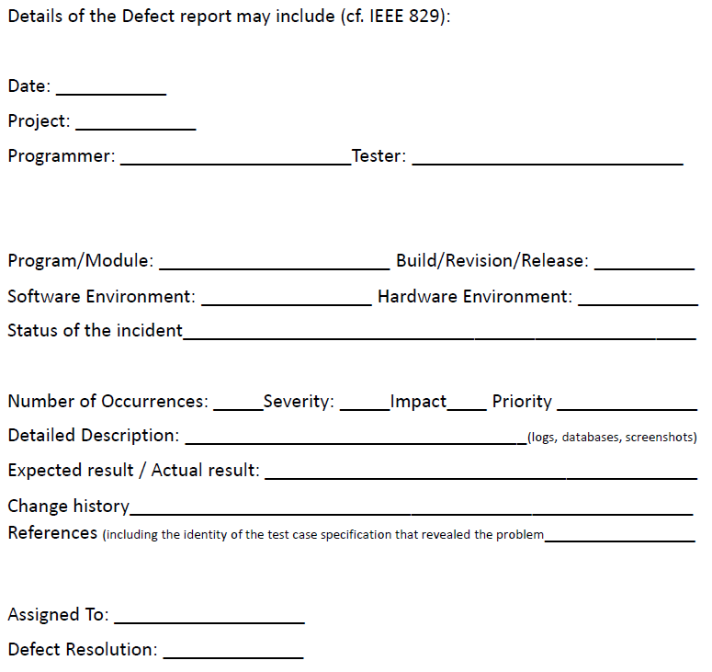
Defect reports

